Slide 1
Capstone Engagement
Assessment, Analysis, and Hardening of a Vulnerable System

Slide 2
Table of Contents
This document contains the following sections:
01
Network Topology
02
Red Team: Security Assessment
03
Blue Team: Log Analysis and Attack Characterization
Hardening: Proposed Alarms and Mitigation Strategies
04

Slide 3
Network Topology
‹#›

Slide 4
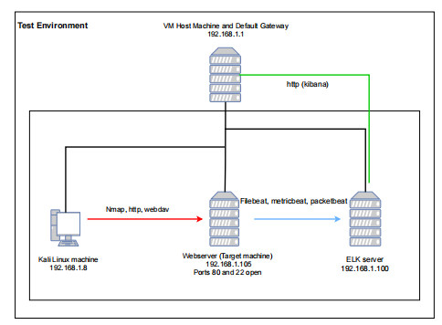
Network Topology
[Insert Here]
Use draw.io to create a diagram of the network.
Add your diagram to this slide and fill out the data in the sidebar.
Network
Address Range:192.168.1.1 - 254
Netmask:255.255.255.0
Gateway:192.168.1.1
Machines
IPv4:192.168.1.1
OS: Windows
Hostname: ML-RefVm-726242
IPv4:192/168.1.8
OS: Linux
Hostname:kali
IPv4:192.168.1.100
OS: Linux
Hostname: ELK
IPv4:192.168.1.105
OS: Linux
Hostname: server1

Slide 5

Red Team
Security Assessment
‹#›

Slide 6
Recon: Describing the Target
Nmap identified the following hosts on the network:
Hostname | IP Address | Role on Network
ML-RefVm-726242 | 192.168.1.1 | Host VM machine and default gateway. This machine will be used to view log info via kibana.
Kali | 192.168.1.8 | This machine will be used to identify and attack the target
Server1 (Capstone) | 192.168.1.105 | This is the target machine. It simulates a company webserver and will send log information to the ELK server
ELK | 192.168.1.100 | This machine will collect the log information and make it available over http.

Slide 7
Vulnerability Assessment
The assessment uncovered the following critical vulnerabilities in the target:
Vulnerability | Description | Impact
HTTP Port 80 (Open) | This is an insecure port and allows unrestricted access - it would be better to use HTTPS | Attacker is able to connect directly using a web browser and explore the file structure
Files are easily accessible, unencrypted and not protected by a password | Allows attacker to read potentially sensitive information | Attacker was able to access sensitive information and discover the location of a secret folder
Passwords used are weak in strength | Passwords used clear text with no special characters and were only 8 chars long | Password was cracked using hydra - a tool that uses brute force
Webdav poorly protected | Webdav area accessible from anywhere. Password hash was broken by using online tool. | Attacker could easily find out the password by cracking the hash online. Then a payload could be uploaded and a reverse meterpreter session established

Slide 8
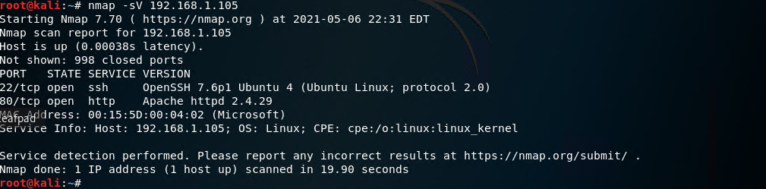
Exploitation: HTTP Port 80 (Open)
01
Tools & Processes
Nmap was used to scan the ip range to check for machines on the network, and then to scan for open ports and service versions
03
[INSERT: screenshot or command output illustrating the exploit.]
02
Achievements
It was discovered that 3 other machines were on the network and their ip addresses. It also showed which ports were open on which machines allowing the target machine to be identified and scanned in more detail..

Slide 9
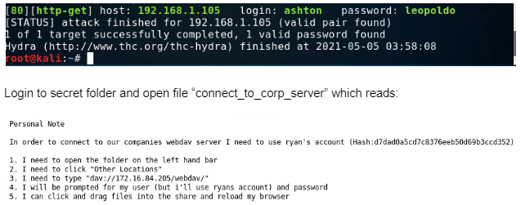
Exploitation: Files are easily accessible, unencrypted and not protected by a password
01
Tools & Processes
Firefox was used to browse the site and read the files that were available. These gave away sensitive information about the location of the secret folder and the credentials required to access it.
03
[INSERT: screenshot or command output illustrating the exploit.]
02
Achievements
Location of the secret folder was located and the name of the user required to access it. Hydra was used to brute force attack the secret folder. The password was discovered and access to the folder was achieved.

Slide 10
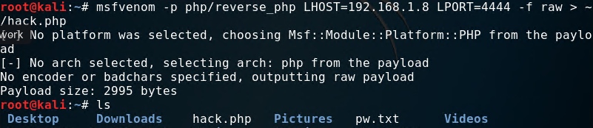
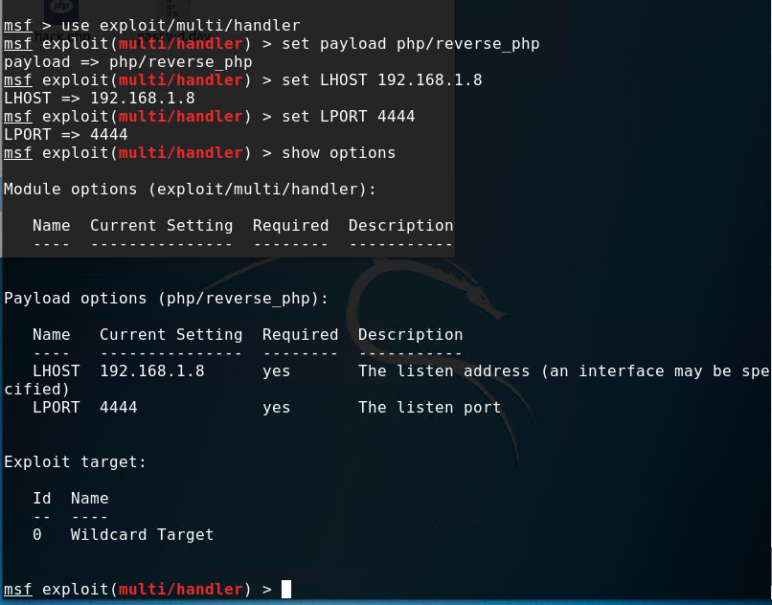
Exploitation: WebDav poorly protected
01
Tools & Processes
The hash for the password for WebDav was easily cracked using an online tool “Crackstation”. Metasploit Venom was used to create a payload which was transferred to the WebDav folder. Metasploit was then used to use the payload to gain access to the machine using a reverse meterpreter shell
03
02
Achievements
A reverse meterpreter shell was created and full access to the target machine achieved

Slide 11
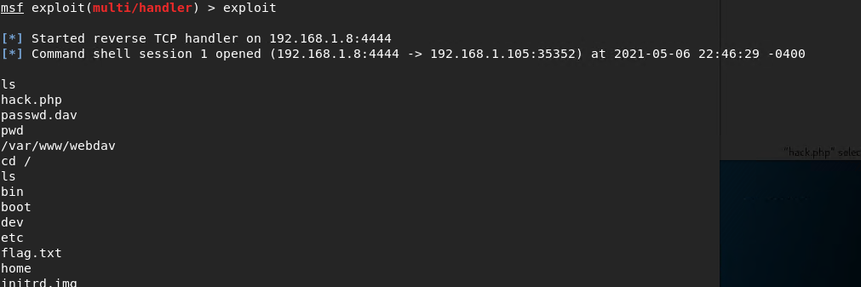
Additional screen shots

Slide 12

Blue Team
Log Analysis and Attack Characterization
‹#›

Slide 13

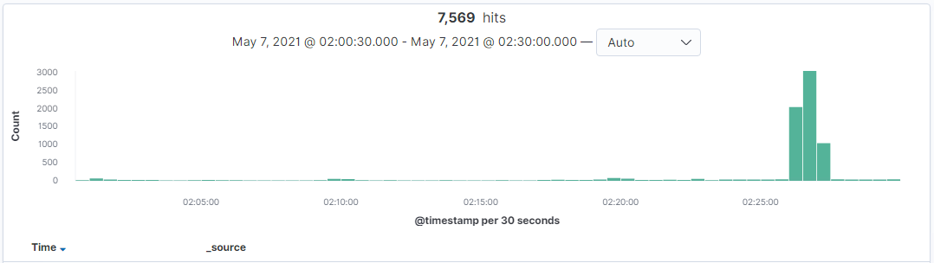
Analysis: Identifying the Port Scan
Answer the following questions in bullet points under the screenshot if space allows. Otherwise, add the answers to speaker notes.
What time did the port scan occur?
How many packets were sent, and from which IP?
What indicates that this was a port scan?
[Insert Here]
Include a screenshot of Kibana logs depicting the port scan.
Unusual activity can be seen occurring between 2:26:00 and 2:27:30
Traffic is originating from one ip address, namely 192.168.1.8
Traffic consists of only 1 packet at a time being sent to many different ports on the target machine

Slide 14
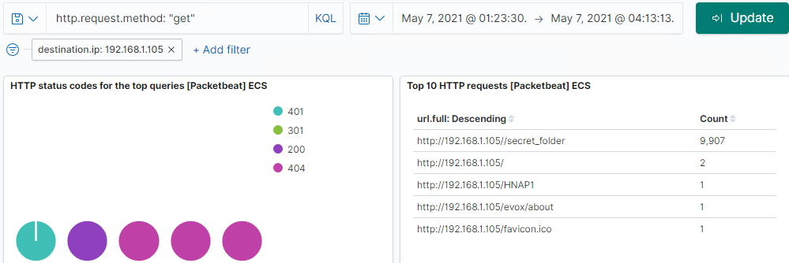
Analysis: Finding the Request for the Hidden Directory
Answer the following questions in bullet points under the screenshot if space allows. Otherwise, add the answers to speaker notes.
What time did the request occur? How many requests were made?
Which files were requested? What did they contain?
[Insert Here]
Include a screenshot of Kibana logs depicting the request for the hidden directory.

Slide 15
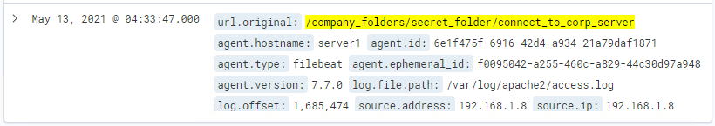
Analysis: Finding the Request for the Hidden Directory (2)
This request is out of sync with other logs as the lab was reset and logs have been lost and some activities appear out of order.
This request occurred May 13 2021 at 04:33:47.000 and requested the file “connect_to_corp_server”

Slide 16
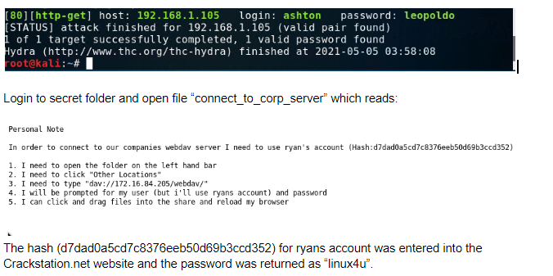
Analysis: Finding the Request for the Hidden Directory (3)
Lab had to be reset and not all activities are shown in sequential order but we can see from the above the requested file (highlghted in yellow on the previous slide) .
The file contained instructions and a login credentials to access the webdav folder (see above)

Slide 17
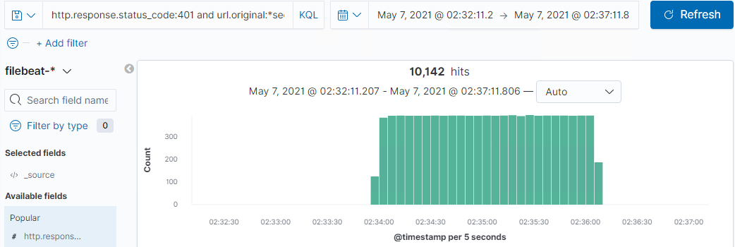
Analysis: Uncovering the Brute Force Attack
Answer the following questions in bullet points under the screenshot if space allows. Otherwise, add the answers to speaker notes.
How many requests were made in the attack?
How many requests had been made before the attacker discovered the password?
[Insert Here]
Include a screenshot of Kibana logs depicting the brute force attack.
According to the above request from filebeat, 10,142 failed authentication requests were made

Slide 18
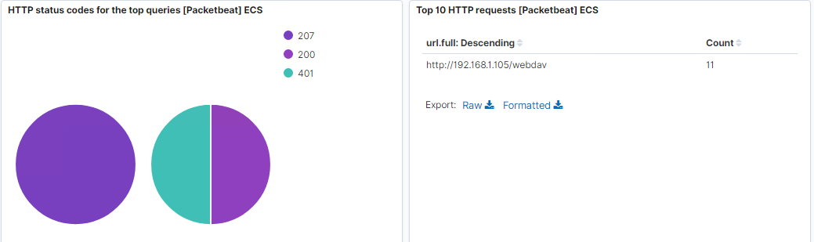
Analysis: Finding the WebDAV Connection
Answer the following questions in bullet points under the screenshot if space allows. Otherwise, add the answers to speaker notes.
How many requests were made to this directory?
Which files were requested?
[Insert Here]
Add a screenshot of Kibana logs depicting the WebDAV connection.
11 requests were made including 1 with code 200

Slide 19
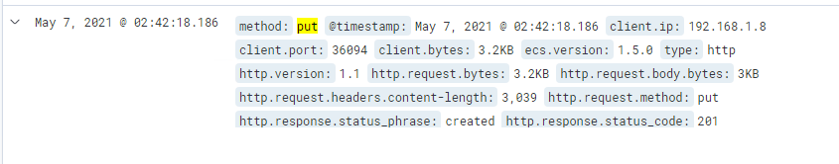
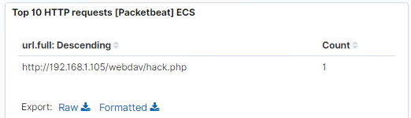
Analysis: Finding the WebDAV Connection
See http request to PUT file into the webdav folder
As seen above, the hack.php file was placed into the webdav folder. This file is a payload created by msfvenom and results in a meterpreter session being established on the target machine.

Slide 20
Blue Team
Proposed Alarms and Mitigation Strategies
‹#›

Slide 21
Mitigation: Blocking the Port Scan
What kind of alarm can be set to detect future port scans?
Alarms can be set if traffic from one ip address is coming in to many ports (incl. ones that are not open.)
Also Alarms should be set to recognise known characteristics of an nmap scan eg: get / HNAP1 and POST /sdk
What threshold would you set to activate this alarm?
Low, perhaps 3 or 4 (but should be reviewed after implementation to prevent alarm fatigue)
What configurations can be set on the host to mitigate port scans?
Ensure that all unused ports are closed
Implement a host based WAF to identify if ports are being scanned by a single ip and blacklist that ip
Describe the solution. If possible, provide required command lines.
As mentioned, instal a host based WAF and blacklist any ip’s that are identified as attempting to access many ports in a short space of time

Slide 22
Mitigation: Finding the Request for the Hidden Directory
What kind of alarm can be set to detect future unauthorized access?
The hidden directory should be accessible from only specified(trusted) ip addresses. An alarm should be raised for any attempts to access this directory from any other IP address especially repeated attempts
What threshold would you set to activate this alarm?
A low threshold should be set eg: more than 3 failed attempts to access the directory per a minute
What configuration can be set on the host to block unwanted access?
There should be a lockout period set after a number of failed attempts.And/or the folder should be subjected to a whitelisting policy.
Describe the solution. If possible, provide required command lines.
In addition to the above, the contents of the folder could be encrypted eg: using openssl
openssl enc -pbkdf2 -nosalt -aes-256-cbc -in connect_to_corp_server -out connect_to_corp_server.enc -base64 -K 89E01536AC207279409D4DE1E5253E01F4A1769E696DB0D6062CA9B8F56767C8 -iv EE99333010B23C01E6364E035E97275C

Slide 23
Mitigation: Preventing Brute Force Attacks
What kind of alarm can be set to detect future brute force attacks?
An alarm should be raised if there is an authorisation failure multiple times from the same source.
What threshold would you set to activate this alarm?
3 failed attempts per minute would be a good starting point for this alarm - it can be altered in future if required
What configuration can be set on the host to block brute force attacks?
The host can be configured to lockout a source after a number of failed attempts. Or alternatively a delay could be set between attempts increasing each time. This would stop most brute force attempts
Describe the solution. If possible, provide the required command line(s).
See above for possible solutions

Slide 24
Mitigation: Detecting the WebDAV Connection
What kind of alarm can be set to detect future access to this directory?
A whitelist can be set up for access to this directory and any attempt from another source could raise an alarm
What threshold would you set to activate this alarm?
Again, a low threshold would be required, maybe after 5 attempts in 5 minutes.
What configuration can be set on the host to control access?
Access to the WebDav folder should be password protected and whitelisted to only allow access to authorised individuals.
Describe the solution. If possible, provide the required command line(s).
In addition to the above the webserver (incl. webdav) should be upgraded to use https instead of http.

Slide 25
Mitigation: Identifying Reverse Shell Uploads
What kind of alarm can be set to detect future file uploads?
Any http “PUT” or “POST” request that uploads a file should be identified and an alarm raised, especially if from an unrecognised source.
What threshold would you set to activate this alarm?
A low threshold is needed for this unless the webserver is intended to allow file sharing etc… The threshold would really depend on the intended use of the server.
What configuration can be set on the host to block file uploads?
Firstly HTTPS should be used not HTTP.
Blacklisting or whitelisting can also be employed depending on the function of the server.
A WAF could also be installed to prevent uploads.
Describe the solution. If possible, provide the required command line.
See above

